Slide 1
Empirical characterization of random Forest variable importance measure
Gaurav Kumar(402742)
Ved Nerlikar(403953)

Slide 2
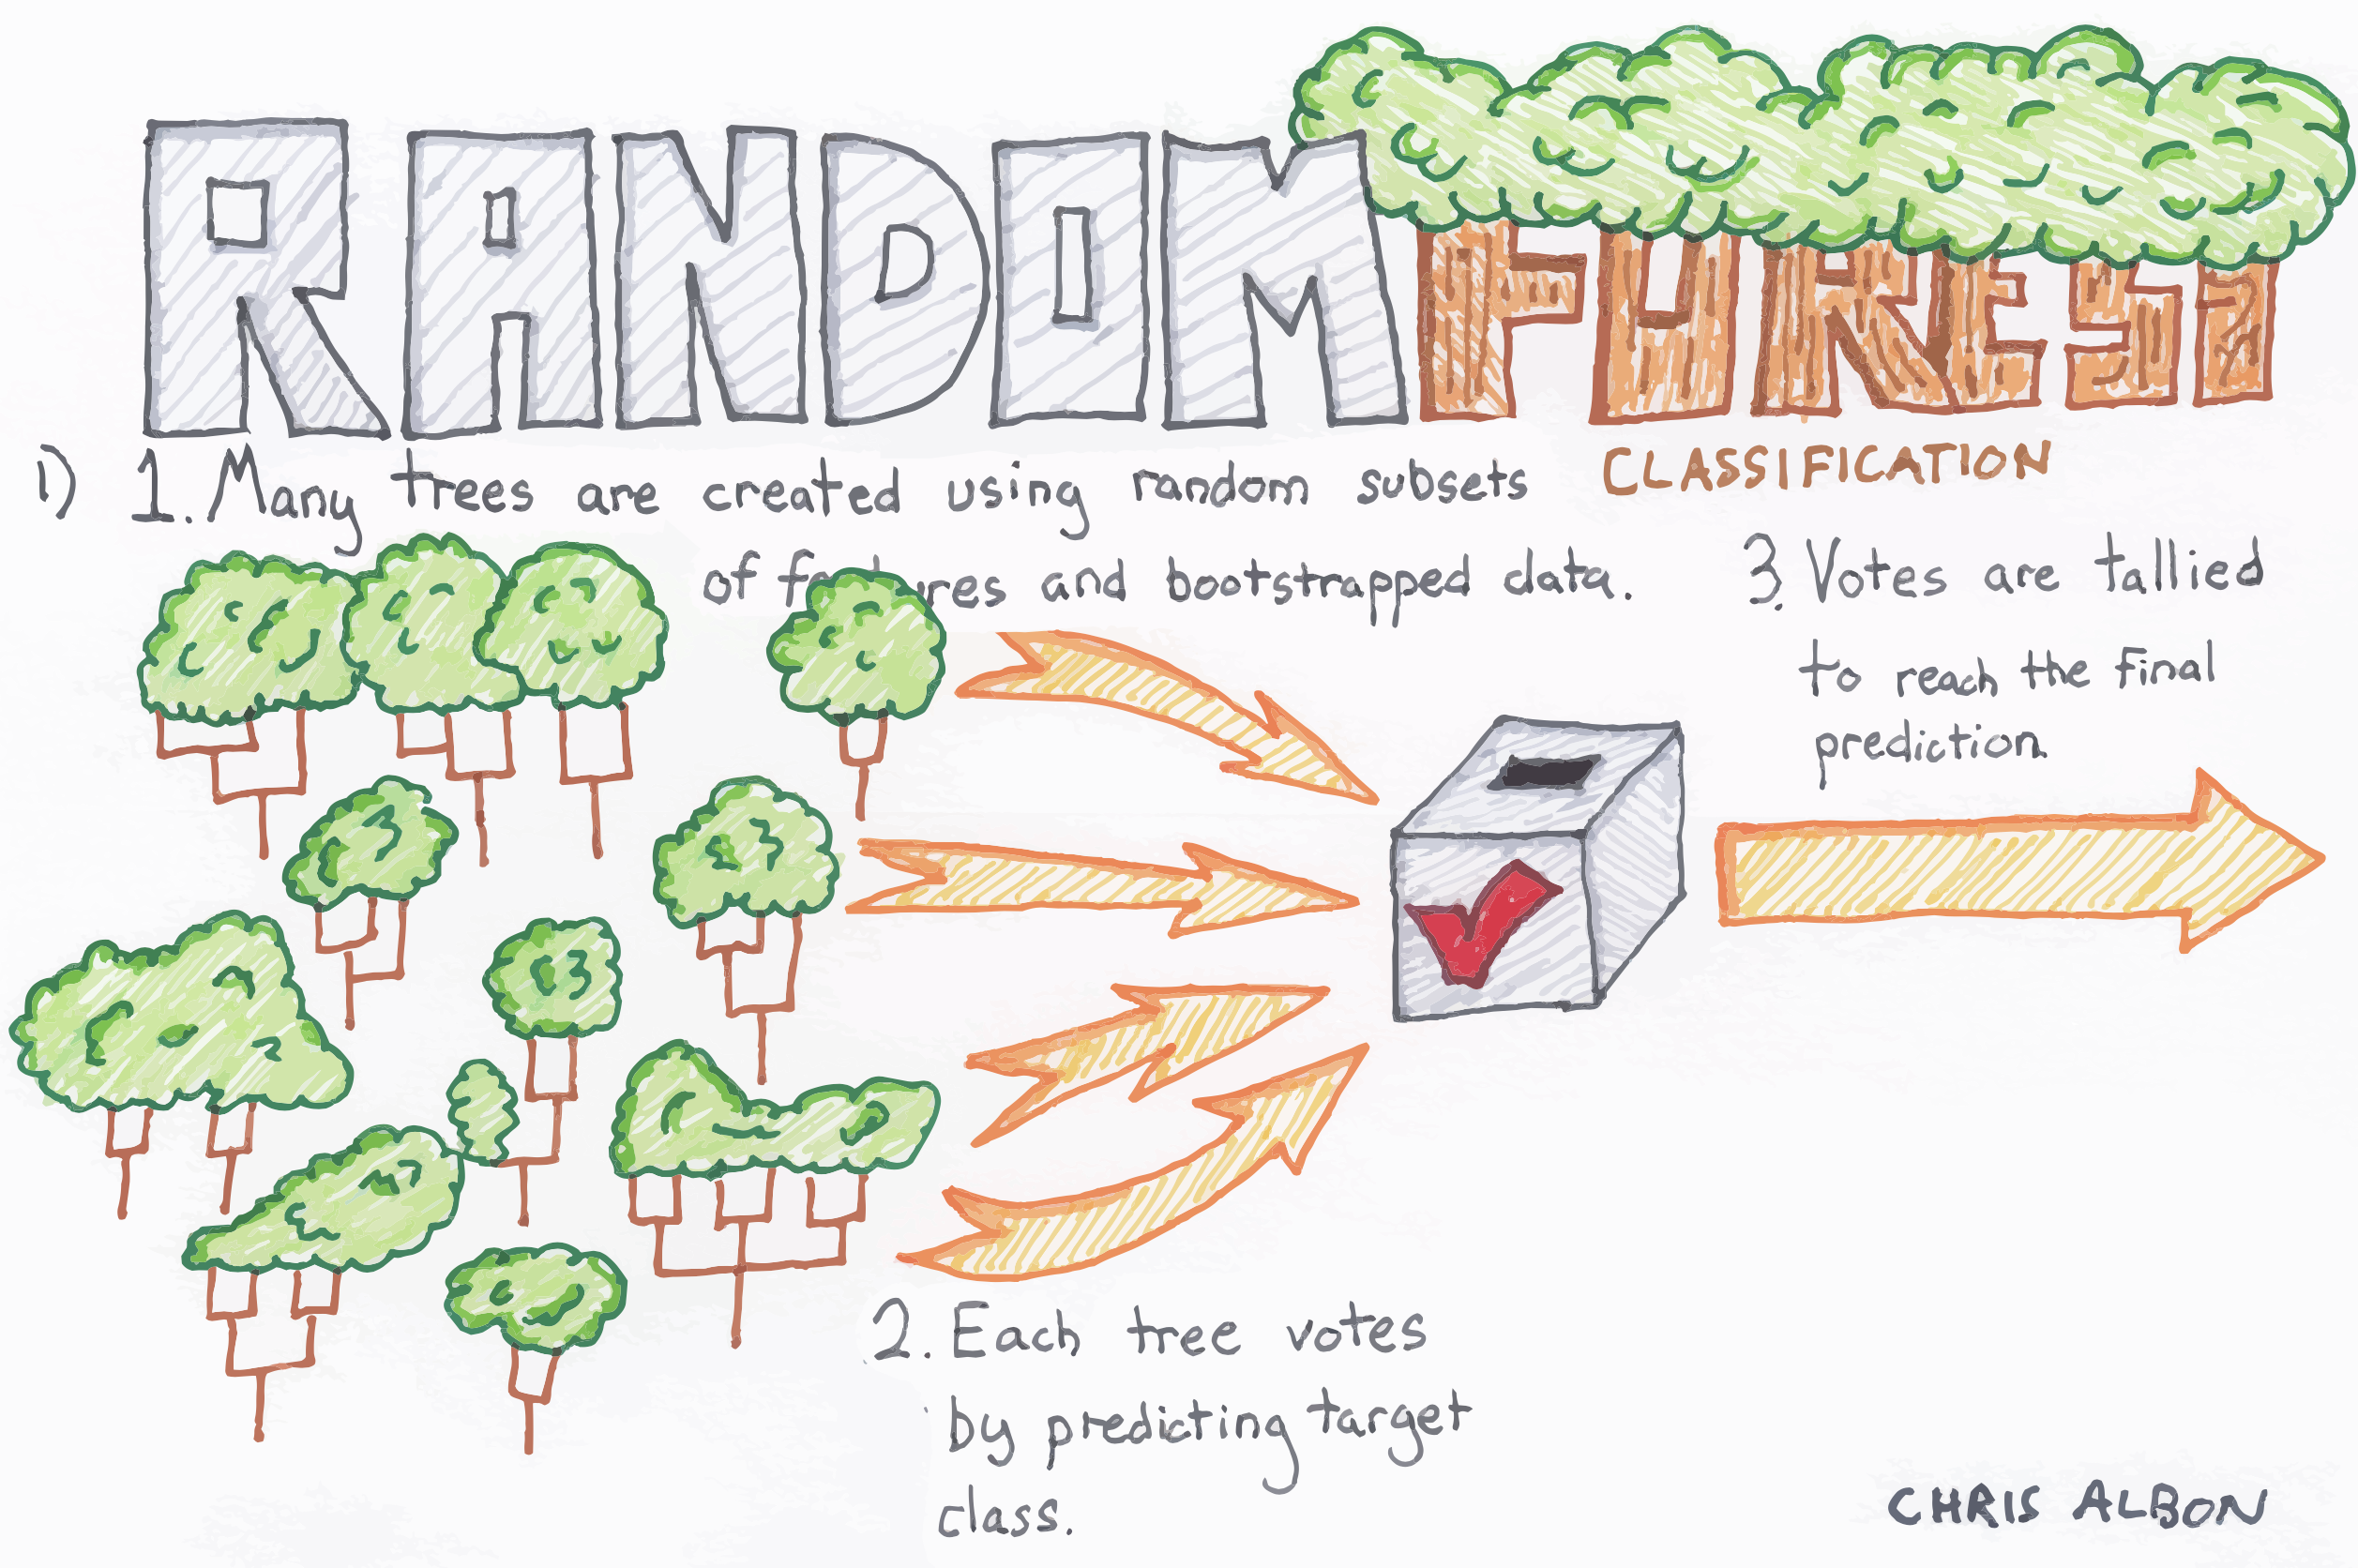

Slide 3
Objective
This Paper examined the effectiveness of Random Forest Variable importance measure in identifying the true predictor among a large number of candidate predictors.
Goal of this Paper is to produce an accurate classifier and to uncover the predictive structure of the Problem.

Slide 4
Introduction
If the candidate predictors (p) large than observations (n) { p>n) , traditional statistical modelling approaches are not estimateable.
In our case, p >> n, there will likely be a mulitplicity of models, most of which have commparable error estimates. However, each model may provide a different interpretation of the underlying biological mechanism.
KNN, SVM, Neural Network, are used for classification but this Methods does not provide insight regarding the covariates that best contribute to predictive structure.
Classification trees have been useful in predicting class membership of an observation using a large set of p covariates. Additionally CTs also provide insight regarding which covariates are the important predictors but unfortunately they are very sensitive to small changes in the learning sample and have therefore been identifies as unstable learners.
Random Forest methodology is attractive for use in classification problem , it produce an accurate classifier and provide insight regarding the disscriminant ability of Individual predictor variable. RF also yield variable importance measure for each candidate predictor

Slide 5
Random Forest & Algorithm
Random Forest method is a specific instance of Bootstrap aggregating
Random Forest improved accuracy and it provides measure of variable importance for each candidate predictor
Random Forest have additional charachteristic of random feature selection at each node and no pruning or stopping rule

Slide 6
The Random Selection of features at each nodes decreses the correlation between the tree in the forest and it helps in decresing the forest error rate
Gini Criterion is used to select the split with the lowest impurity at each nodes
Works on Voting mechanism , maximum number of votes among the B-Tree in the Forest is the predicted class of an observation
RF‘s run efficiently on a large dataset and can handle thousand of input variable

Slide 7
Variable Importance measure
The average differnece in accuracy of the out of bag error versus permuted out of bag observation Over the B-Tree is know as variable importance measure
Two useful by product of Random Forest
a. Out of bag estimation of generalization error
b. Variable Importance measure
Implementation of algorithm for calcualating variable importance measure is done in the Random Forest R Package.

Slide 8
Some Study on Variable Importance Measure :
In 2004 Cummings and Myers come up with intresting application of variable imporatance measure that is in Identifying the sequnece features that effect edited sites in plant mitochondrial RNA
In 2006 Uriarte and Andres proposed an iterative Gene selection procedure where designated percent of genes with lowest variable importance measure are discarded and a new RF is derived until the out of bag error is within one standard error of the Minimum out of bag error etimates

Slide 9
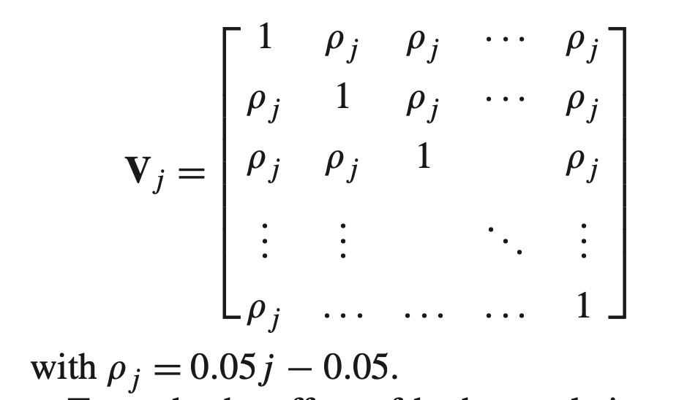

Simulation
100 multivariate normal variables in 20 blocks, with each block consisting of 40 variables, were randomly generated.
Means of multivariate normal random variables were randomly generated from a uniform distribution on the interval [6,12].
The observations (i) generated in blocks (j) with nested covariates (k) within each block are denoted by x_{i,j,k} having a block diagonal covariance matrix. Each block V_{j} is a K*K matrix.
To study the effect of both correlation and strength of predictor, a simulation study was conducted for each combination of j correlations and $l$levels of $β ε \left(0.025,0.50,0.75,1.00,1.25,1.50,1.75\right).$ 140 simulations were performed and for each simulations, a dichotomous response was generated.
The first covariate within each block of correlated covariates was used as true predictor in generating a dichotomous response.

Slide 10
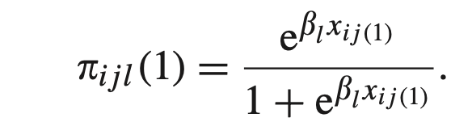
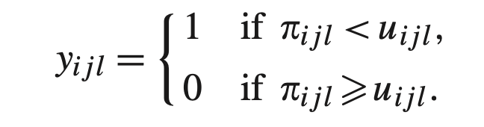
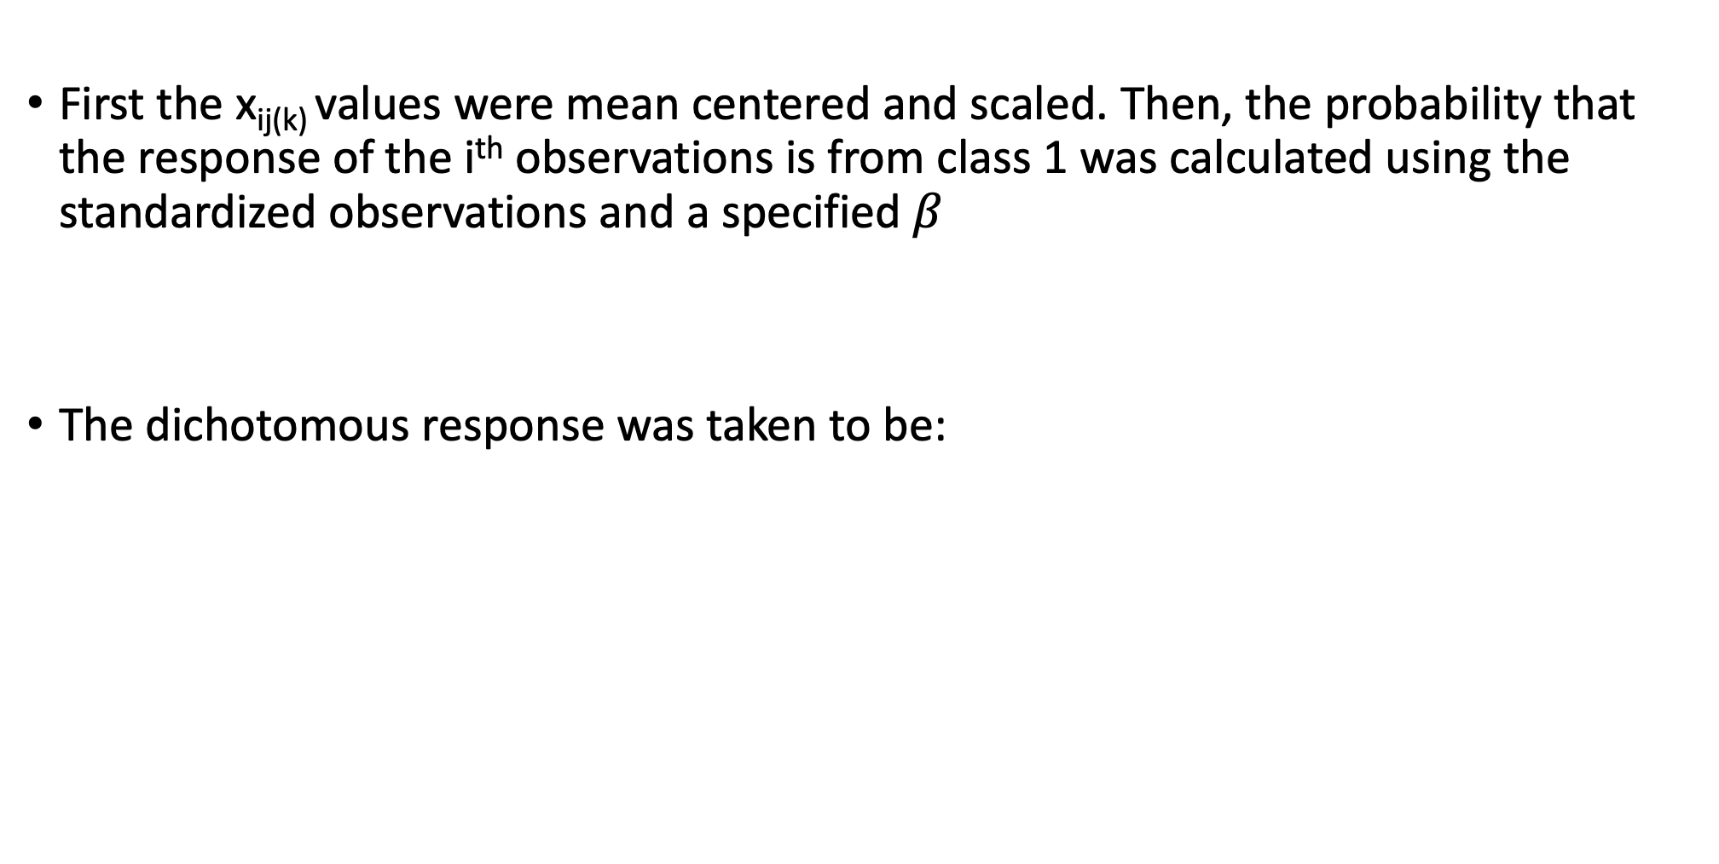
Simulation
First the x_{ij(k)} values were mean centered and scaled. Then, the probability that the response of the i^{th} observations is from class 1 was calculated using the standardized observations and a specified $β$
The dichotomous response was taken to be:

Slide 11
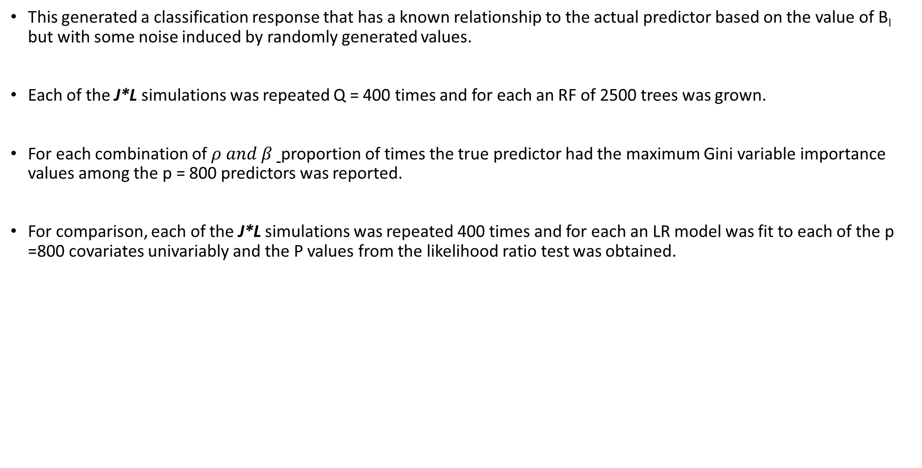
Simulation
This generated a classification response that has a known relationship to the actual predictor based on the value of B_{l} but with some noise induced by randomly generated values.
Each of the J*L simulations was repeated Q = 400 times and for each an RF of 2500 trees was grown.
For each combination of $ρ and β$ proportion of times the true predictor had the maximum Gini variable importance values among the p = 800 predictors was reported.
For comparison, each of the J*L simulations was repeated 400 times and for each an LR model was fit to each of the p =800 covariates univariably and the P values from the likelihood ratio test was obtained.

Slide 12
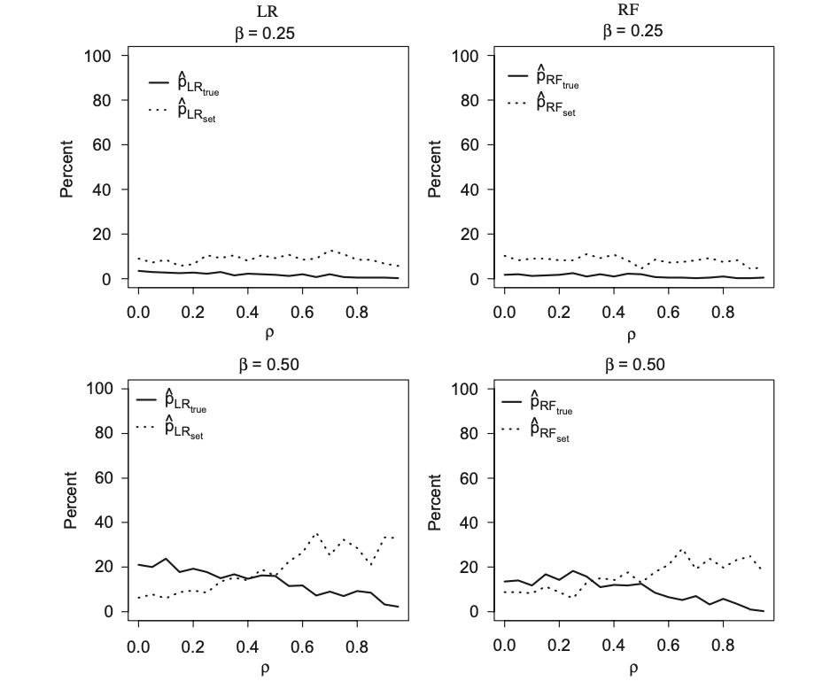
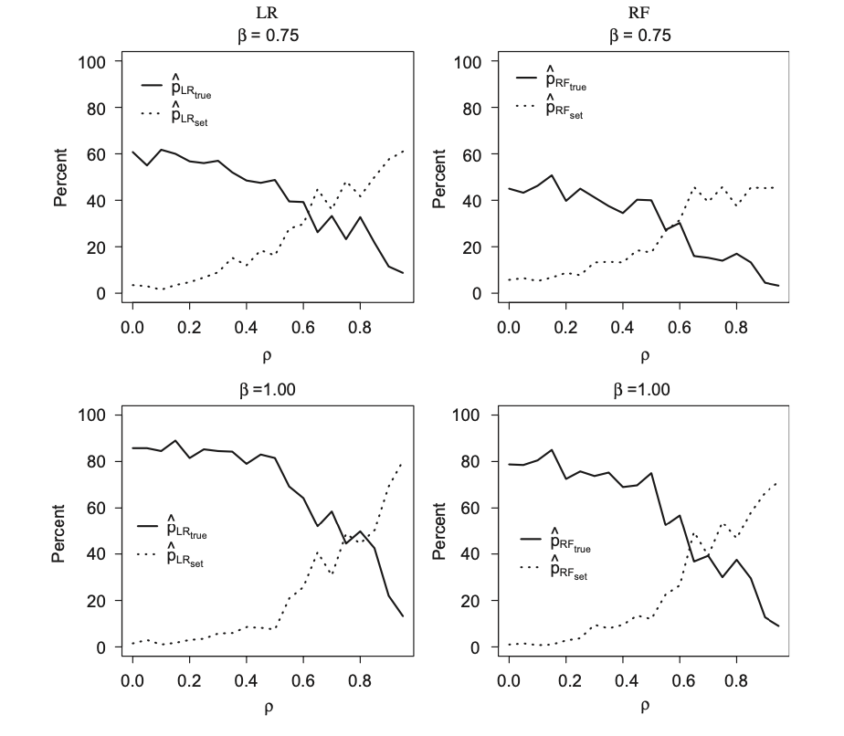
Simulation
Figure 1.
Figure 2.

Slide 13
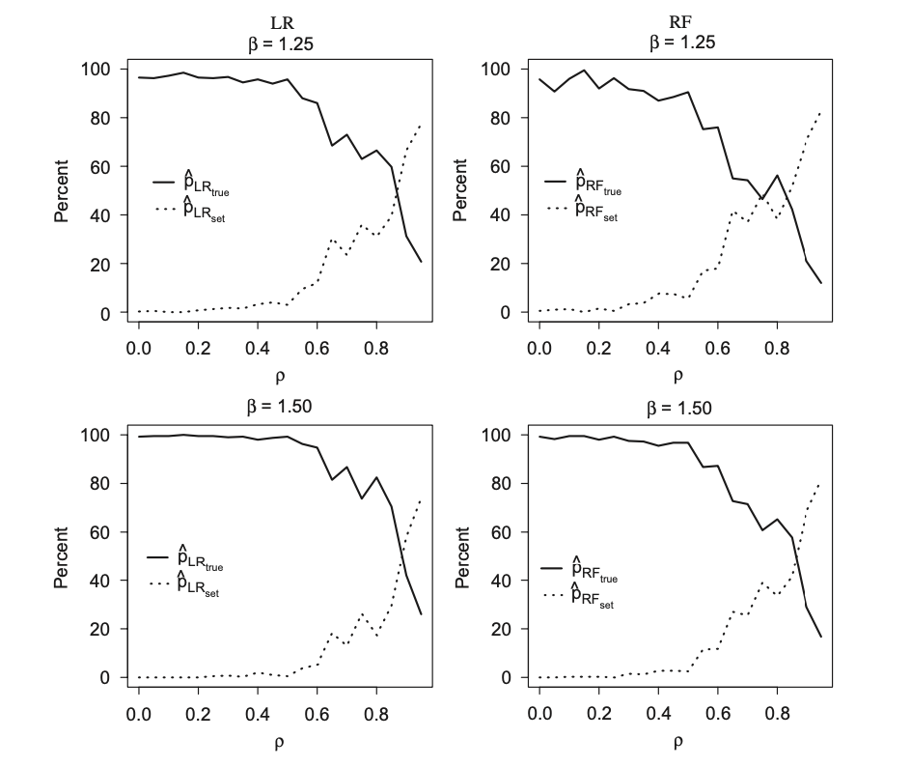
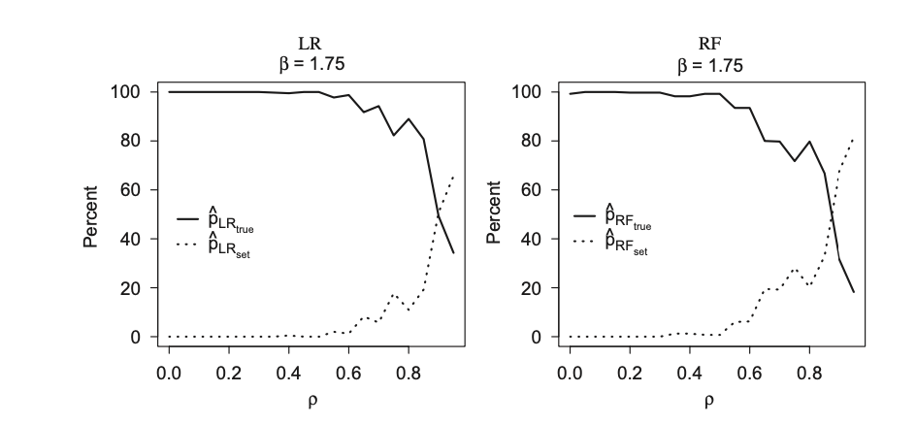
Simulation
Figure 4
Figure 3

Slide 14
Case application
This study is done on the publicly available data consiting of gene expression and associated phenotype information for 128 adult acute lymphocytic leukemia .In this study flow cytometry was used to determine whether the celllular origin of all was B-Lineage or T lineage
A hypergeometric test was used in assessing whether or not there were more probe set annoted for specific GO molecular function called significant by our k-mean clustering .
Intrestingly GO term which are identified by the k-means cluster that exhibited the maximum mean variable importance are biologically relevant , since T and B lineage all differ by surface markers ,antigens ,receptors and signal transduction pathways.

Slide 15
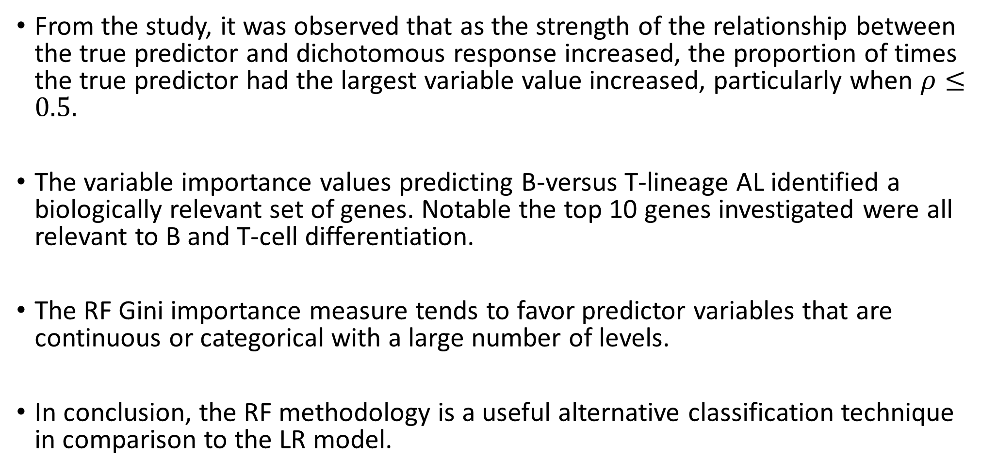
Observations:
From the study, it was observed that as the strength of the relationship between the true predictor and dichotomous response increased, the proportion of times the true predictor had the largest variable value increased, particularly when $ρ≤0.5.$
The variable importance values predicting B-versus T-lineage AL identified a biologically relevant set of genes. Notable the top 10 genes investigated were all relevant to B and T-cell differentiation.
The RF Gini importance measure tends to favor predictor variables that are continuous or categorical with a large number of levels.
In conclusion, the RF methodology is a useful alternative classification technique in comparison to the LR model.

Slide 16
Limitation:
Random Forest variable importance measure may yields misleading result when the predictors variable are of different types or when the numbers of level among the categorical variable vary.
This paper suggest that it is particularly attractive for the Gene expression studies as in this area ,analyst does not have to do feature selection Prior to deriving the classifier.
This paper was relevant only to microarray Gene expression classification problem in which all predictor are standardized ,continous and often correlated.

Slide 17
Thank you

